Slide 1
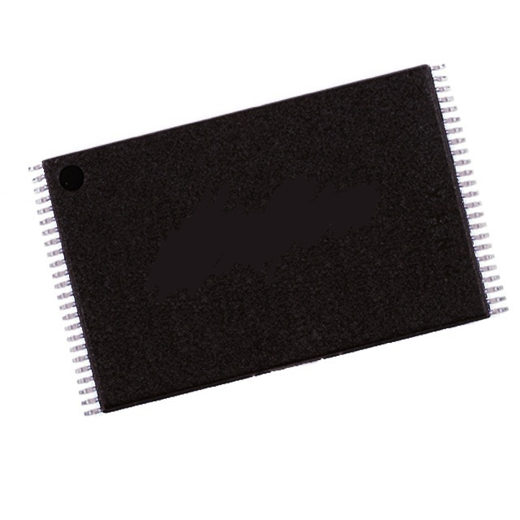
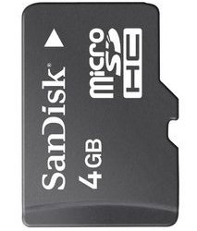
4
Copy data from mmcblk0p2 to mtd5
5
Sanitize mmcblk0p2
Save
Export
data
mtd5
Export
Save
data
2
3
Delete or modify
digital evidence
Sanitize mtd5
1
Copy data from mtd5 to mmcblk0p2

